Slide 1
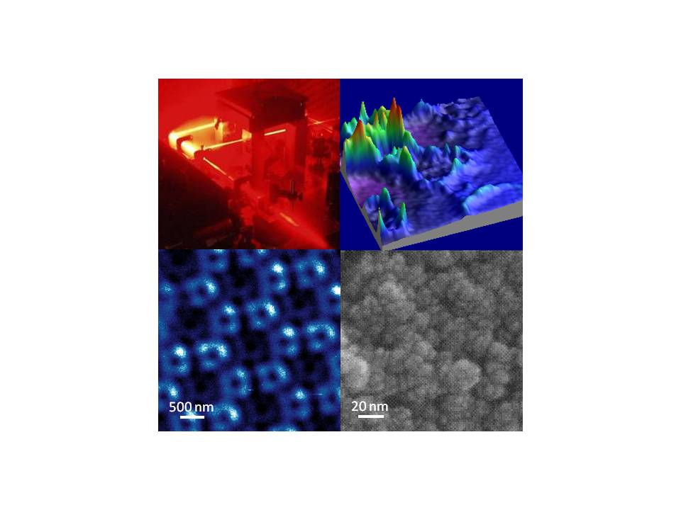
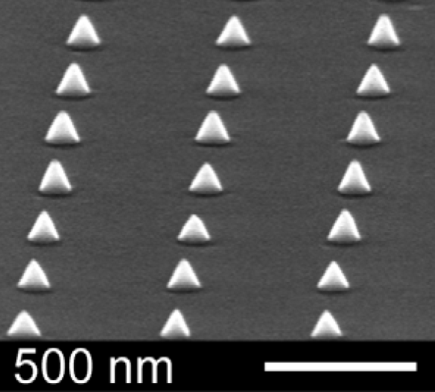
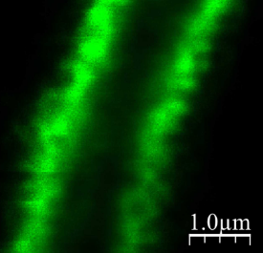
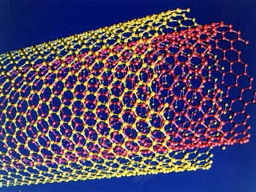
Introduction to Nano-Science I
Einführung in die Nano-Science I
Prof. Dr. Frank Schreiber (Studiendekan)
frank.schreiber@uni-tuebingen.de
Tel.78663, office C7A35
http://www.soft-matter.uni-tuebingen.de
MON & THU 15-17 in BioIII / N10-50
Outline
1. Who are we ?
2. What is nano-science ?
3. Why do we do nano-science ?
→ Fundamental questions
→ Applications
4. What is going to come ?
→ Tools and methods
→ Preparation
→ Effects
5. Organisation and logistics (Üner in the break)
www.uni-tuebingen.de/nano-science
Notes:
X-ray diffraction measurements were performed at the esrf(european synchrotron radiation facility) in grenoble.
In a portable chamber films of approx 20nm thickness at roomtemperature were grown.

Slide 2

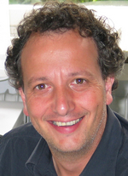
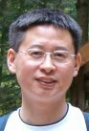
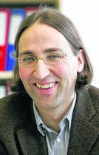



Introduction to Nano-Science I
Who are we ?
Prof. Dr. Frank Schreiber (Studiendekan)
frank.schreiber@uni-tuebingen.de
Tel.78663, office C7A35
http://www.soft-matter.uni-tuebingen.de
Biology
Physics
Chemistry
Prof. Dr. Klaus Harter
Dr. Fajun Zhang
Prof. Dr. Reiner Anwander
Dr. Üner Kolukisaoglu (Studienkoordination)
Dr. Monika Fleischer
Dr. Yucang Liang
Notes:
X-ray diffraction measurements were performed at the esrf(european synchrotron radiation facility) in grenoble.
In a portable chamber films of approx 20nm thickness at roomtemperature were grown.

Slide 3
Introduction to Nano-Science I
What is Nano-Science ?
What is Nano-Science ?
Notes:
X-ray diffraction measurements were performed at the esrf(european synchrotron radiation facility) in grenoble.
In a portable chamber films of approx 20nm thickness at roomtemperature were grown.

Slide 4
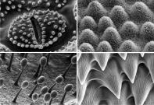
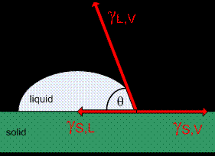
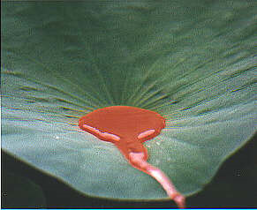
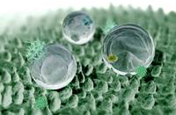

Introduction to Nano-Science I
What is Nano-Science ?
  “Nano-Science” summarises the scientific areas concerned with
  materials and effects on the nano-meter scale (1 nm=0.000000001 m)
  (note that “nano one dimension (i.e. thin films)” is enough to qualify)
  Interdisciplinary in nature (biology / chemistry / physics)
  (including applications and engineering)
An example: Lotus effect

Slide 5
Introduction to Nano-Science I
What is Nano-Science ?
Figure prepared by Yucang Liang

Slide 6
Introduction to Nano-Science I
What is Nano-Science ?
General remarks
Consider relevant orders of magnitude
… length scales
… time scales
… energy scales
… temperature scales
Methods for Characterisation
... microscopy
... scattering
... spectroscopy
Notes:
X-ray diffraction measurements were performed at the esrf(european synchrotron radiation facility) in grenoble.
In a portable chamber films of approx 20nm thickness at roomtemperature were grown.

Slide 7
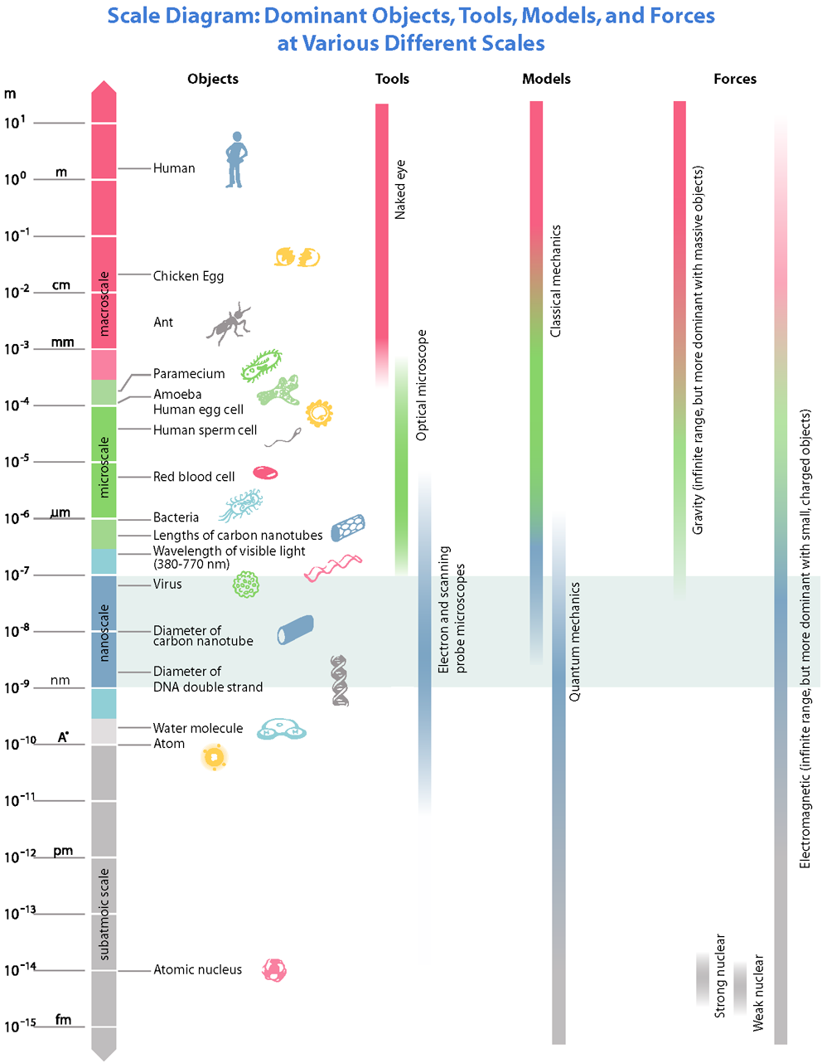

Slide 8
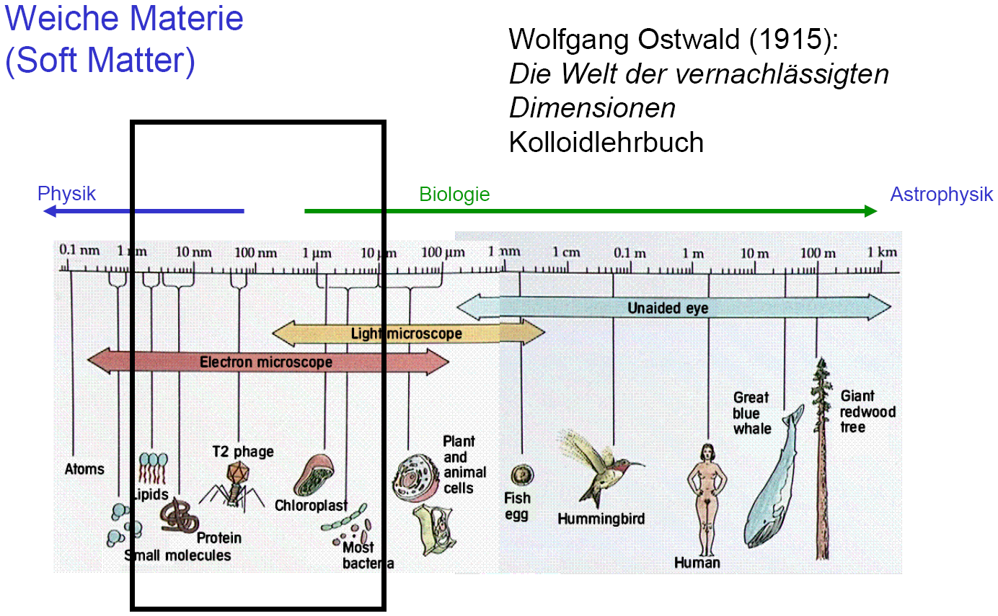
Introduction to Nano-Science I
What is Nano-Science ?
Notes:
X-ray diffraction measurements were performed at the esrf(european synchrotron radiation facility) in grenoble.
In a portable chamber films of approx 20nm thickness at roomtemperature were grown.

Slide 9
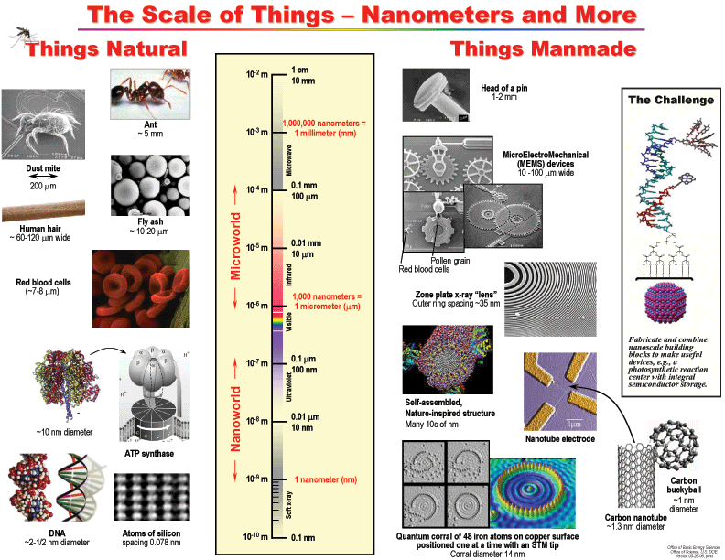
Introduction to Nano-Science I
What is Nano-Science ?
Available in Nature
Manmade/synthetically prepared
Pin head
~ 1-2 mm
Ant
~ 5 mm
MicroElectroMechanical
(MEMS) devices
~ 10-100 μm
Dust mite
~ 200 μm
Human hair
~ 60-120 μm wide
Fly ash
~ 10-20 μm
Pollen grain
Red blood cells
~ 7-8 μm
Red blood cells
Zone plate X-ray “lens”
Outer ring space ~ 35 nm
Fabricate and combine nanoscale building blocks to make useful devices, e.g. photosynthetic reaction center with storage
Self-assembled structure
dimensions ~ 10s of nm
10 nm diameter
Nanotube electrode
ATP synthase
Carbon
buckyball
~ 1 nm
DNA
~ 2-1/2 nm diameter
Atoms of Silicon
spacing ~ 0.078 nm
Carbon nanotube
~ 1.3 nm diameter
Quantum corral of 48 Fe atoms on Cu surface
using STM tip; Coral diameter ~ 14 nm
Notes:
X-ray diffraction measurements were performed at the esrf(european synchrotron radiation facility) in grenoble.
In a portable chamber films of approx 20nm thickness at roomtemperature were grown.

Slide 10
Introduction to Nano-Science I
What is Nano-Science ?
Note that there are not only length scales,
but also time and energy scales
Notes:
X-ray diffraction measurements were performed at the esrf(european synchrotron radiation facility) in grenoble.
In a portable chamber films of approx 20nm thickness at roomtemperature were grown.

Slide 11
Introduction to Nano-Science I
What is Nano-Science ?
Note that there are not only length scales,
but also time and energy scales
Notes:
X-ray diffraction measurements were performed at the esrf(european synchrotron radiation facility) in grenoble.
In a portable chamber films of approx 20nm thickness at roomtemperature were grown.

Slide 12
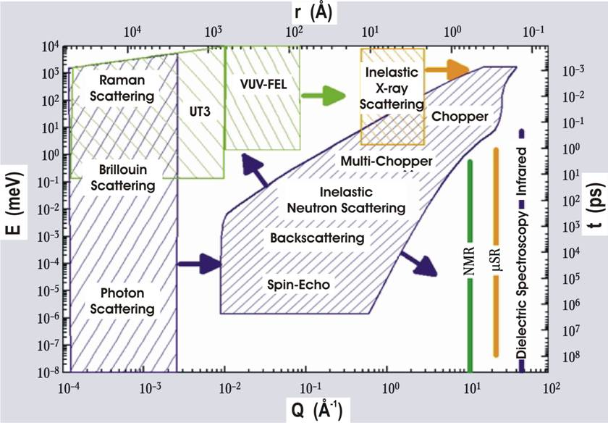
Introduction to Nano-Science I
What is Nano-Science ?
Note that there are not only length scales,
but also time and energy scales
E = hω = hν → h/t
i.e. order of magnitude: energy 1 meV → time scale ~1 ps
Notes:
X-ray diffraction measurements were performed at the esrf(european synchrotron radiation facility) in grenoble.
In a portable chamber films of approx 20nm thickness at roomtemperature were grown.

Slide 13
Introduction to Nano-Science I
What is Nano-Science ?
If you want to understand function,
you need to study structure
(added later by Zewail and others:)
… and dynamics.
Notes:
X-ray diffraction measurements were performed at the esrf(european synchrotron radiation facility) in grenoble.
In a portable chamber films of approx 20nm thickness at roomtemperature were grown.

Slide 14
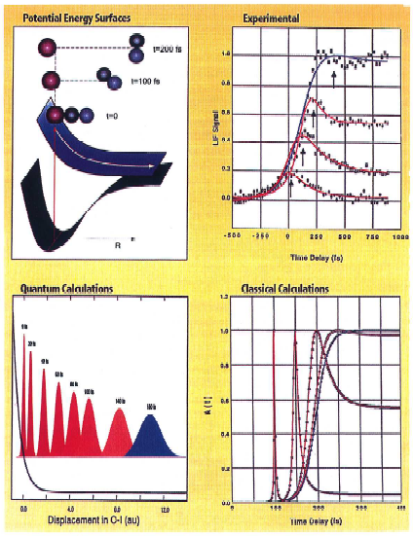
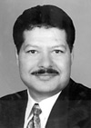

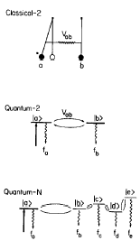
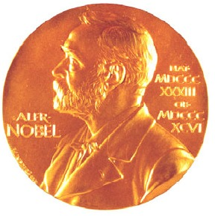
Introduction to Nano-Science I
What is Nano-Science ?
Ahmed
Zewail
Nobel Prize 1999
in Chemistry
"for his studies of the transition states of chemical reactions using femtosecond spectroscopy "
Notes:
X-ray diffraction measurements were performed at the esrf(european synchrotron radiation facility) in grenoble.
In a portable chamber films of approx 20nm thickness at roomtemperature were grown.

Slide 15
Introduction to Nano-Science I
What is Nano-Science ?
Notes:
X-ray diffraction measurements were performed at the esrf(european synchrotron radiation facility) in grenoble.
In a portable chamber films of approx 20nm thickness at roomtemperature were grown.

Slide 16
Introduction to Nano-Science I
Why do we do Nano-Science ?
Why do we do Nano-Science ?
Notes:
X-ray diffraction measurements were performed at the esrf(european synchrotron radiation facility) in grenoble.
In a portable chamber films of approx 20nm thickness at roomtemperature were grown.

Slide 17
Introduction to Nano-Science I
Why do we do Nano-Science ?
Why do we do Nano-Science ?
Fundamental issues
& Applications
Notes:
X-ray diffraction measurements were performed at the esrf(european synchrotron radiation facility) in grenoble.
In a portable chamber films of approx 20nm thickness at roomtemperature were grown.

Slide 18
Introduction to Nano-Science I
Why do we do Nano-Science ?
Fundamental issues
How do things work on the microscopic level ?
→ in solids ? (e.g, Do we understand crystallisation of proteins ?)
→ in chemistry ?
→ in biology ? (from Hamiltonians to Life ?)
Small is different ? … new effects ?
→ magnetic recording (perpendicular magnetisation)
→ giant magneto-resistance (GMR)
→ Mermin-Wagner-theorem (“magnetism breaks down in pure 2D“)
→ melting point changes for small particles compared to bulk
→ limits of microelectronics ?
Small is different ? … new material properties ?
→ colour effects of nano-particles
→ quantum transport
→ …
Notes:
X-ray diffraction measurements were performed at the esrf(european synchrotron radiation facility) in grenoble.
In a portable chamber films of approx 20nm thickness at roomtemperature were grown.

Slide 19
Introduction to Nano-Science I
Why do we do Nano-Science ?
Applications
New material properties, e.g.
→ small is different
→ new structures (e.g., open frameworks)
New effects, e.g.
→ magnetic recording (perpendicular magnetisation)
→ giant magneto-resistance (GMR)
→ colour effects
New sensing applications, e.g.
→ various microscopy techniques
→ field enhancement near nanoparticles
(see section on nano-science and biology)
4. …
Notes:
X-ray diffraction measurements were performed at the esrf(european synchrotron radiation facility) in grenoble.
In a portable chamber films of approx 20nm thickness at roomtemperature were grown.

Slide 20
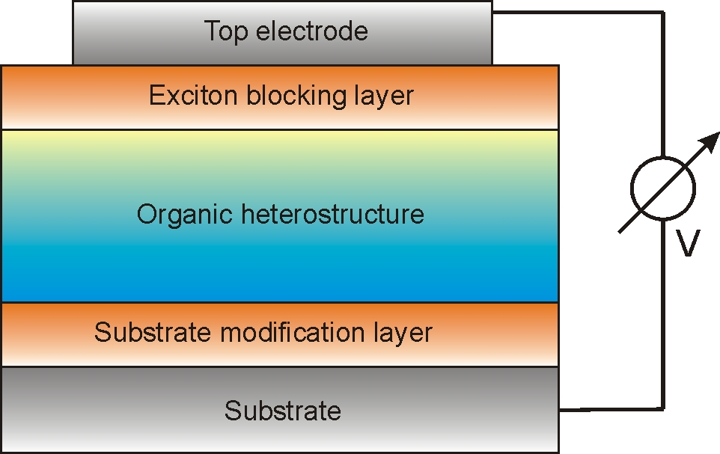
Introduction to Nano-Science I
Why do we do Nano-Science ?
Example: Making Organic Photovoltaics Devices
nanoparticles
heterostructure
(Several components)
interfaces
→ This is a very complicated architecture !
→ There is lots of work for nano-scientists to improve this !
based on Alexander Hinderhofer and Frank Schreiber, ChemPhysChem (2012)
Notes:
X-ray diffraction measurements were performed at the esrf(european synchrotron radiation facility) in grenoble.
In a portable chamber films of approx 20nm thickness at roomtemperature were grown.

Slide 21
Introduction to Nano-Science I
What is going to come in Nano-Science I ?
What is going to come
in Nano-Science I ?
Notes:
X-ray diffraction measurements were performed at the esrf(european synchrotron radiation facility) in grenoble.
In a portable chamber films of approx 20nm thickness at roomtemperature were grown.

Slide 22
Introduction to Nano-Science I
What is going to come in Nano-Science I ?
Outline of the lecture is not really:
1. Nano-Science and Biology
2. Nano-Science and Physics
3. Nano-Science and Chemistry
Notes:
X-ray diffraction measurements were performed at the esrf(european synchrotron radiation facility) in grenoble.
In a portable chamber films of approx 20nm thickness at roomtemperature were grown.

Slide 23
Introduction to Nano-Science I
What is going to come in Nano-Science I ?
Outline of the lecture is rather:
1. Making nano-materials:
Top-down vs. Bottom-up
2. Making nano-materials:
Nano-chemistry
3. Properties & applications of nano-materials:
Gold nanoparticles as a prototype example
4. Nano-science and biology:
Advanced microscopy tools and beyond
Notes:
X-ray diffraction measurements were performed at the esrf(european synchrotron radiation facility) in grenoble.
In a portable chamber films of approx 20nm thickness at roomtemperature were grown.

Slide 24
Introduction to Nano-Science I
What is going to come in Nano-Science I ?
Making nano-materials:
Top-down vs. Bottom-up
(Fajun Zhang and Monika Fleischer)
Notes:
X-ray diffraction measurements were performed at the esrf(european synchrotron radiation facility) in grenoble.
In a portable chamber films of approx 20nm thickness at roomtemperature were grown.

Slide 25


Introduction to Nano-Science I
What is going to come in Nano-Science I ?
Making nano-structures
Manipulation of atoms on surfaces …
Smart chemistry …
Lithography and beyond …
”Bottom up“ fabrication:
(Self organized) arrangement of atoms, molecules or particles, e.g. by chemical synthesis. Very small particles possible, limited control over shape and position.
”Top down“ fabrication:
Fabrication of individual structures from extended material, often miniaturization of existing concepts. Good control over position and shape, downsizing limited.
Notes:
X-ray diffraction measurements were performed at the esrf(european synchrotron radiation facility) in grenoble.
In a portable chamber films of approx 20nm thickness at roomtemperature were grown.

Slide 26
Introduction to Nano-Science I
What is going to come in Nano-Science I ?
Making nano-structures
Manipulation of atoms on surfaces …
Smart chemistry …
Lithography and beyond …
”Bottom up“ fabrication:
(Self organized) arrangement of atoms, molecules or particles, e.g. by chemical synthesis. Very small particles possible, limited control over shape and position.
”Top down“ fabrication:
Fabrication of individual structures from extended material, often miniaturization of existing concepts. Good control over position and shape, downsizing limited.
Notes:
X-ray diffraction measurements were performed at the esrf(european synchrotron radiation facility) in grenoble.
In a portable chamber films of approx 20nm thickness at roomtemperature were grown.

Slide 27
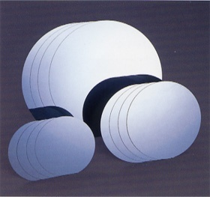
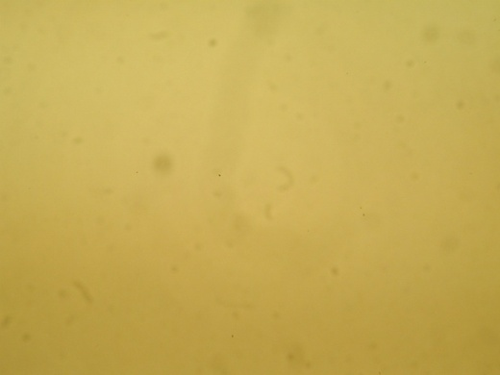
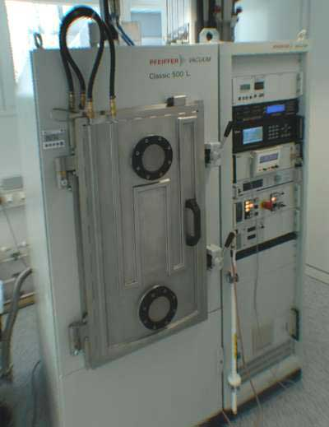
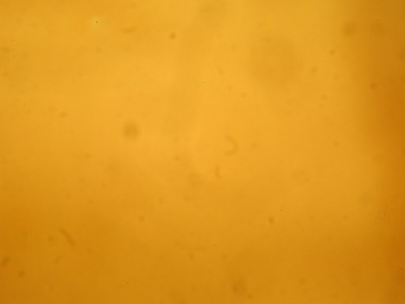
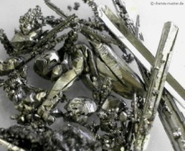
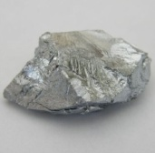
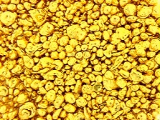
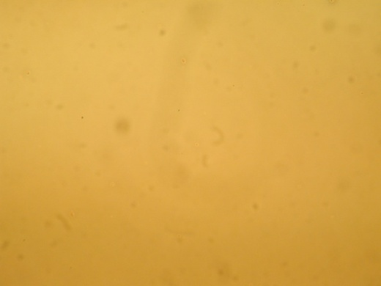
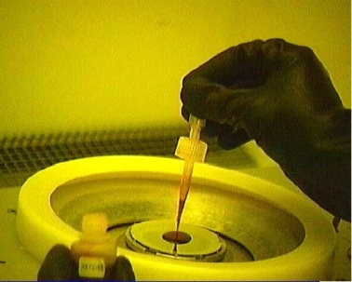
Fabrication process - example
Si
Silicon wafer
Si
Cr
Au
Ti
Si
2) Evaporation of Ti, Au and Cr
Si + Ti/Au/Cr
HSQ
Cr
Au
Ti
Si
3) Spin-coating with HSQ
negative e-beam resist
Si + Ti/Au/Cr + HSQ
F. Stade et al., Microelectron. Eng. 84, 1589 (2007); M. Fleischer et al., Nanotechnology 21, 065301 (2010)

Slide 28
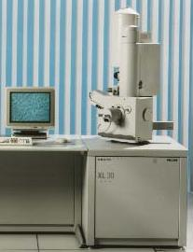
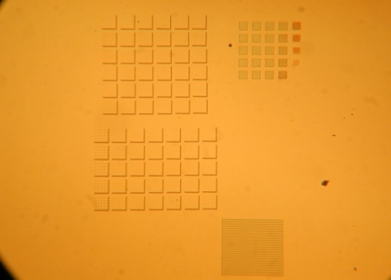
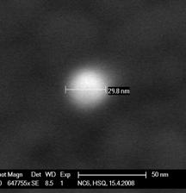
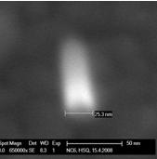
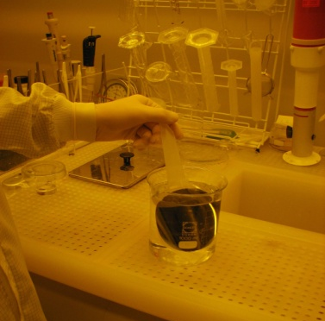
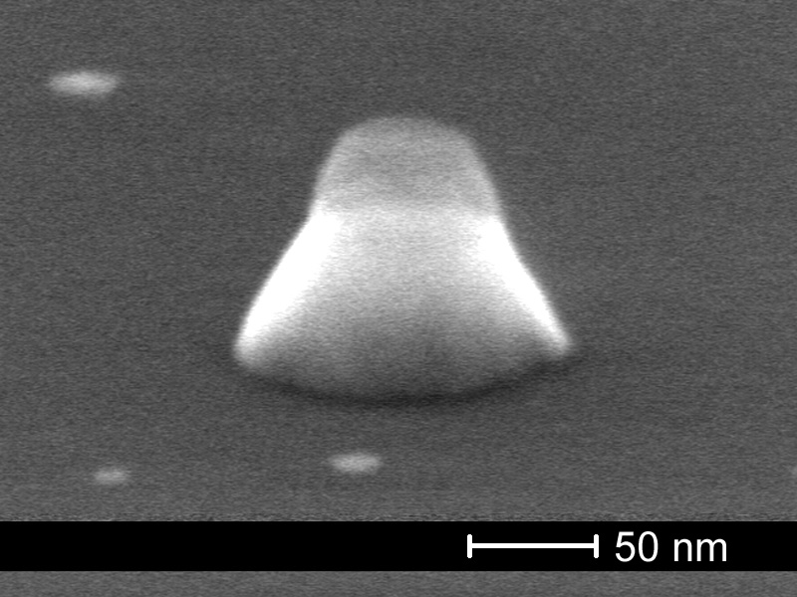
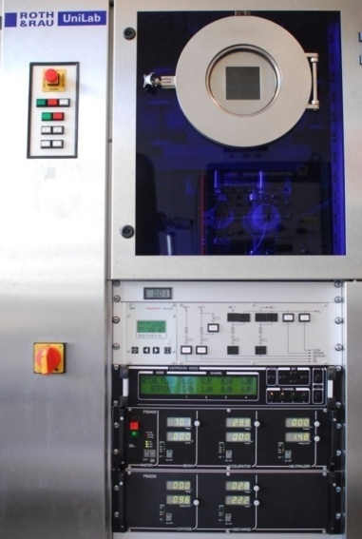
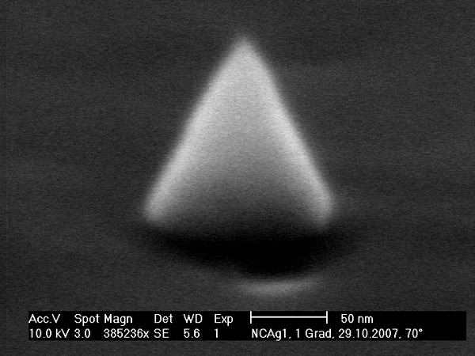

Fabrication process - example
HSQ
Cr
Au
Ti
Si
50nm
50 μm
4) Electron beam exposure,
development with TMAH
Si + Ti/Au/Cr + HSQ
50nm
HSQ
Cr
Au
Ti
Si
5) Transfer into metal by ion
etching
Au
Ti
Si
6) HSQ removal by further
ion etching
50 nm
F. Stade et al., Microelectron. Eng. 84, 1589 (2007); M. Fleischer et al., Nanotechnology 21, 065301 (2010)

Slide 29
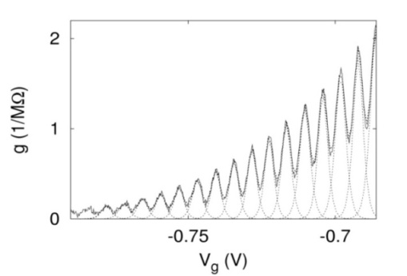
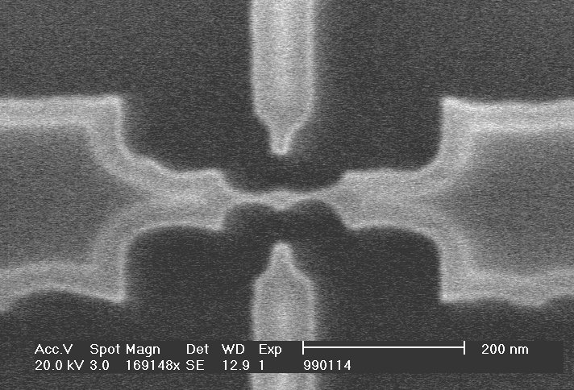
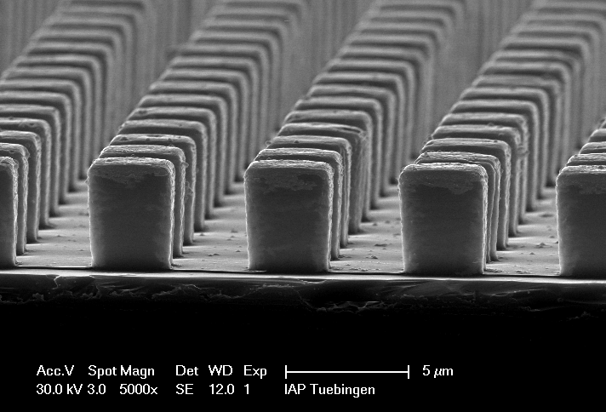
Functional micro- and nanostructures
Courtesy of Kern / Fleischer group, Tübingen
Resist characterization ●
● Microgrippers
Single electron transistors ●
● Microfluidic channels
Carbon nanotubes ●
● Bio templates
Plasmonic nanostructures ●
5 µm

Slide 30
Introduction to Nano-Science I
What is going to come in Nano-Science I ?
Notes:
X-ray diffraction measurements were performed at the esrf(european synchrotron radiation facility) in grenoble.
In a portable chamber films of approx 20nm thickness at roomtemperature were grown.

Slide 31
Introduction to Nano-Science I
What is going to come in Nano-Science I ?
Making nano-structures
Manipulation of atoms on surfaces …
Smart chemistry …
Lithography and beyond …
”Bottom up“ fabrication:
(Self organized) arrangement of atoms, molecules or particles, e.g. by chemical synthesis. Very small particles possible, limited control over shape and position.
”Top down“ fabrication:
Fabrication of individual structures from extended material, often miniaturization of existing concepts. Good control over position and shape, downsizing limited.
Notes:
X-ray diffraction measurements were performed at the esrf(european synchrotron radiation facility) in grenoble.
In a portable chamber films of approx 20nm thickness at roomtemperature were grown.

Slide 32
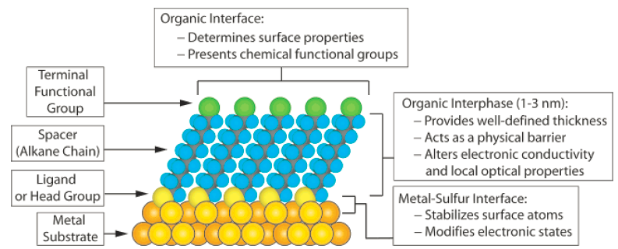
Introduction to Nano-Science I
What is going to come in Nano-Science I ?
Surface modification by self-assembled monolayers (SAMs)
as a form of nano-technology
Applications of SAMs
Tailoring wetting, adsorption, and growth
Docking of adsorbates, e.g. biomolecules
Corrosion protection
…
Love et al., Chem. Rev. 105 (2005), 1103
Schreiber, Prog. Surf. Sci. 65 (2000) 151
Notes:
X-ray diffraction measurements were performed at the esrf(european synchrotron radiation facility) in grenoble.
In a portable chamber films of approx 20nm thickness at roomtemperature were grown.

Slide 33
Introduction to Nano-Science I
What is going to come in Nano-Science I ?
Growth of thin films
Notes:
X-ray diffraction measurements were performed at the esrf(european synchrotron radiation facility) in grenoble.
In a portable chamber films of approx 20nm thickness at roomtemperature were grown.

Slide 34
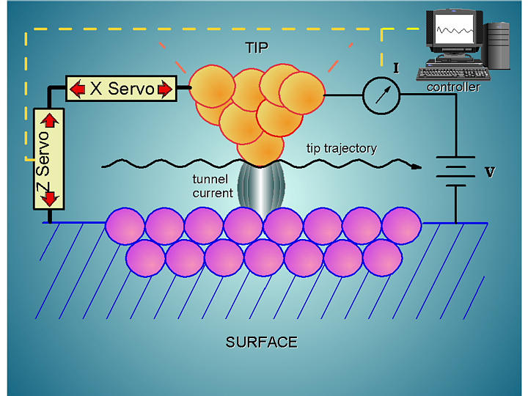
Introduction to Nano-Science I
What is going to come in Nano-Science I ?
Principle of Scanning Tunneling Microscopy ‚(STM)
Notes:
X-ray diffraction measurements were performed at the esrf(european synchrotron radiation facility) in grenoble.
In a portable chamber films of approx 20nm thickness at roomtemperature were grown.

Slide 35
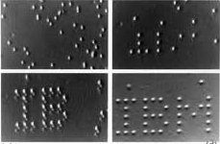
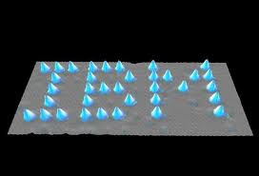
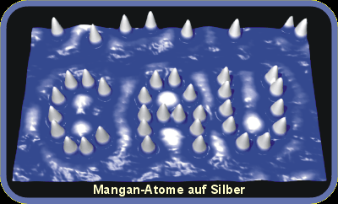
Introduction to Nano-Science I
What is going to come in Nano-Science I ?
Images by Don Eigler (IBM)
Recorded by STM at low T
after manipulation of atoms
See also Don Eigler talk on YouTube
Images by Richard Berndt (Kiel)
Recorded by STM at low T
after manipulation of atoms
Notes:
X-ray diffraction measurements were performed at the esrf(european synchrotron radiation facility) in grenoble.
In a portable chamber films of approx 20nm thickness at roomtemperature were grown.

Slide 36
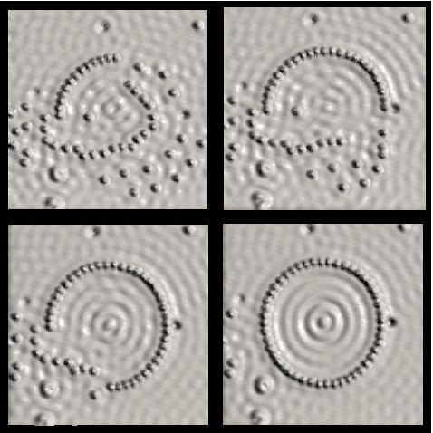
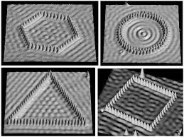
Introduction to Nano-Science I
What is going to come in Nano-Science I ?
Images by Don Eigler (IBM)
Recorded by STM at low T after manipulation of atoms
TEDxCaltech - Don Eigler - Moving Atoms, one-by-one
http://www.youtube.com/watch?v=rd2dri9p_EI
Notes:
X-ray diffraction measurements were performed at the esrf(european synchrotron radiation facility) in grenoble.
In a portable chamber films of approx 20nm thickness at roomtemperature were grown.

Slide 37
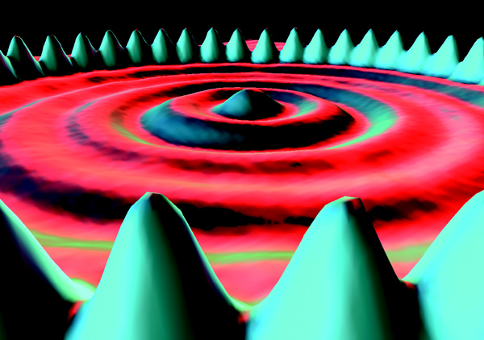
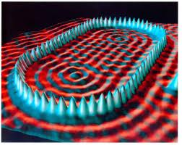
Introduction to Nano-Science I
What is going to come in Nano-Science I ?
Images by Don Eigler (IBM)
Recorded by STM at low T after manipulation of atoms
Here they have positioned 48 iron atoms into a circular ring in order to “corral” some surface state electrons
and force them into “quantum” states of the circular structure. The ripples in the ring of atoms are the
density distribution of a particular set of quantum states of the corral. [Crommie, Lutz & Eigler]
Notes:
X-ray diffraction measurements were performed at the esrf(european synchrotron radiation facility) in grenoble.
In a portable chamber films of approx 20nm thickness at roomtemperature were grown.

Slide 38
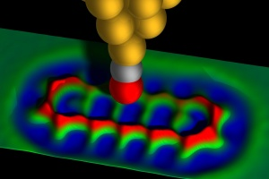

Introduction to Nano-Science I
What is going to come in Nano-Science I ?
Animation
STM data
Images by Gerhard Meyer (IBM)
Image of pentacene on surface, recorded by STM at low T
An example
for making nano-structures
for chemistry,
and for properties on the nano-scale
http://www.youtube.com/watch?v=jnLRl_74BZs
“IBM Scientists First to Image the Anatomy of a Molecule”
Notes:
X-ray diffraction measurements were performed at the esrf(european synchrotron radiation facility) in grenoble.
In a portable chamber films of approx 20nm thickness at roomtemperature were grown.

Slide 39
Introduction to Nano-Science I
What is going to come in Nano-Science I ?
Notes:
X-ray diffraction measurements were performed at the esrf(european synchrotron radiation facility) in grenoble.
In a portable chamber films of approx 20nm thickness at roomtemperature were grown.

Slide 40
Introduction to Nano-Science I
What is going to come in Nano-Science I ?
Making nano-materials:
Nano-chemistry
(Reiner Anwander and Yucang Liang)
Notes:
X-ray diffraction measurements were performed at the esrf(european synchrotron radiation facility) in grenoble.
In a portable chamber films of approx 20nm thickness at roomtemperature were grown.

Slide 41





Introduction to Nano-Science I
What is going to come in Nano-Science I ?
nano-sized
clusters
zeolites
surface
functionalization
carbon „bucky“ tubes
metalorganic
frameworks
Notes:
X-ray diffraction measurements were performed at the esrf(european synchrotron radiation facility) in grenoble.
In a portable chamber films of approx 20nm thickness at roomtemperature were grown.

Slide 42



Introduction to Nano-Science I
What is going to come in Nano-Science I ?
Open-Framework Inorganic Materials
New materials try to emulate nature`s open frameworks
cacoxenite, d_{p} 14.2 Å
{[AlFe₂₄(OH)₁₂(PO₄)₁₇(H₂O)₂₄]×51H₂O}
JDF-20
[Al₅P₆O₂₄H]²⁻
2[N(C₂H₅)₃H]⁺×2H₂O,
14.5×6.5 Å
cloverite (CLO), gallophosphate, d_{p} 13.2 Å
Angew. Chem. Int. Ed. 1999, 38, 3268–3292.
Notes:
X-ray diffraction measurements were performed at the esrf(european synchrotron radiation facility) in grenoble.
In a portable chamber films of approx 20nm thickness at roomtemperature were grown.

Slide 43

Introduction to Nano-Science I
What is going to come in Nano-Science I ?
Notes:
X-ray diffraction measurements were performed at the esrf(european synchrotron radiation facility) in grenoble.
In a portable chamber films of approx 20nm thickness at roomtemperature were grown.

Slide 44



Introduction to Nano-Science I
What is going to come in Nano-Science I ?
Crystalline, Microporous Supports –
Zeolites and Zeotypes
Zeolite Y
12R-pores:
7.4 × 7.4 Å
supercage: d = 13 Å
Zeolite UTD-1
14R-pores:
7.5 × 10 Å
Cloverite (GaPO₄)
20R-pores:
6.0 × 13.2 Å
supercage: d = 30 Å
Notes:
X-ray diffraction measurements were performed at the esrf(european synchrotron radiation facility) in grenoble.
In a portable chamber films of approx 20nm thickness at roomtemperature were grown.

Slide 45


Introduction to Nano-Science I
What is going to come in Nano-Science I ?
Synthesis of a quintessential nano-object:
Gold nano-particles
Method by Turkevich et al. (Reduction by citrate)
A STUDY OF THE NUCLEATION AND GROWTH PROCESSES IN THE SYNTHESIS OF COLLOIDAL GOLD by J. Turkevich, P. C. Stevenson, J. Hillier
DISCUSSIONS OF THE FARADAY SOCIETY (11): 55 (1951)
Citrate as reducing and stabilizing agent
Notes:
X-ray diffraction measurements were performed at the esrf(european synchrotron radiation facility) in grenoble.
In a portable chamber films of approx 20nm thickness at roomtemperature were grown.

Slide 46
Introduction to Nano-Science I
What is going to come in Nano-Science I ?
Notes:
X-ray diffraction measurements were performed at the esrf(european synchrotron radiation facility) in grenoble.
In a portable chamber films of approx 20nm thickness at roomtemperature were grown.

Slide 47
Introduction to Nano-Science I
What is going to come in Nano-Science I ?
Properties & applications of nano-materials:
Gold nanoparticles as a prototype example
(Fajun Zhang)
Notes:
X-ray diffraction measurements were performed at the esrf(european synchrotron radiation facility) in grenoble.
In a portable chamber films of approx 20nm thickness at roomtemperature were grown.

Slide 48
Introduction to Nano-Science I
What is going to come in Nano-Science I ?
Properties & applications of nano-materials:
Gold nanoparticles as a prototype example
(Fajun Zhang)
Colour effects
Near-field effects
Scattering effects
Field enhancement e.g. in organic photovoltaics
Field enhancement e.g. for sensors
AuNPs as marker in biology
Notes:
X-ray diffraction measurements were performed at the esrf(european synchrotron radiation facility) in grenoble.
In a portable chamber films of approx 20nm thickness at roomtemperature were grown.

Slide 49



Introduction to Nano-Science I
What is going to come in Nano-Science I ?
Tailoring of the Optical Properties of Gold Colloids
Au Nanoparticles: Colour as a function of size
Sources: http://www.sharps-jewellers.co.uk/rings/images/bien-hccncsq5.jpg
http://www.foresight.org/Conferences/MNT7/Abstracts/Levi/
Notes:
X-ray diffraction measurements were performed at the esrf(european synchrotron radiation facility) in grenoble.
In a portable chamber films of approx 20nm thickness at roomtemperature were grown.

Slide 50


Introduction to Nano-Science I
What is going to come in Nano-Science I ?
Tailoring of the Optical Properties of Gold Colloids
AuAg Bimetallic Nanoparticles: Alloys vs. Core-Shells
Variation in optical properties
(UV-vis spectra and color)
for AuAg alloy nanoparticle colloids
with varying compositions.
Aqueous dispersions of (from left to right)
Au, Au@Ag, Au@Ag@Au, and Au@Ag@Au@Ag NPs, and the corresponding TEM images.
Au core size: 16 nm.
MPI Golm
Notes:
X-ray diffraction measurements were performed at the esrf(european synchrotron radiation facility) in grenoble.
In a portable chamber films of approx 20nm thickness at roomtemperature were grown.

Slide 51

Introduction to Nano-Science I
What is going to come in Nano-Science I ?
Surface plasmon resonance of metal NP
Intensity enhancement (near field)
Notes:
X-ray diffraction measurements were performed at the esrf(european synchrotron radiation facility) in grenoble.
In a portable chamber films of approx 20nm thickness at roomtemperature were grown.

Slide 52
Introduction to Nano-Science I
What is going to come in Nano-Science I ?
Example: Making Organic Photovoltaics Devices
nanoparticles
heterostructure
(Several components)
interfaces
→ This is a very complicated architecture !
→ There is lots of work for nano-scientists to improve this !
Notes:
X-ray diffraction measurements were performed at the esrf(european synchrotron radiation facility) in grenoble.
In a portable chamber films of approx 20nm thickness at roomtemperature were grown.

Slide 53

Introduction to Nano-Science I
What is going to come in Nano-Science I ?
F. Schreiber, Nature Materials, 10 (2011), 813
Notes:
X-ray diffraction measurements were performed at the esrf(european synchrotron radiation facility) in grenoble.
In a portable chamber films of approx 20nm thickness at roomtemperature were grown.

Slide 54

Introduction to Nano-Science I
What is going to come in Nano-Science I ?
Small-Angle Scattering
Notes:
X-ray diffraction measurements were performed at the esrf(european synchrotron radiation facility) in grenoble.
In a portable chamber films of approx 20nm thickness at roomtemperature were grown.

Slide 55

Introduction to Nano-Science I
What is going to come in Nano-Science I ?
gemessene Intensität
Notes:
X-ray diffraction measurements were performed at the esrf(european synchrotron radiation facility) in grenoble.
In a portable chamber films of approx 20nm thickness at roomtemperature were grown.

Slide 56
Introduction to Nano-Science I
What is going to come in Nano-Science I ?
Notes:
X-ray diffraction measurements were performed at the esrf(european synchrotron radiation facility) in grenoble.
In a portable chamber films of approx 20nm thickness at roomtemperature were grown.

Slide 57
Introduction to Nano-Science I
What is going to come in Nano-Science I ?
Nano-science and biology:
Advanced microscopy tools and beyond
(Klaus Harter and Üner Kolukisaoglu)
… STED microscopy
… STORM (microscopy)
… FCS
… optical tweezers
Notes:
X-ray diffraction measurements were performed at the esrf(european synchrotron radiation facility) in grenoble.
In a portable chamber films of approx 20nm thickness at roomtemperature were grown.

Slide 58



Stimulated Emission Depletion (STED)-Mikroskopie
STED benutzt stimulierte Emission zur Auflösungssteigerung
Die Abbesche Grenze gilt noch immer, der Ausdruck wird um einen Sättigungsterm erweitert

Slide 59




STED-Aufbau und Ergebnis
STED: Aufbau und Ergebnis

Slide 60

Stochastic Reconstruction Microscopy (STORM)
Einzelne Punkte können im konfokalen Bild mit wesentlich höherer Präzision lokalisiert werden, als zwei Punkte getrennt voneinander aufgelöst werden können.
Ein Punkt erscheint im Fluoreszenzbild in der Form der Point Spread Function (PSF):
Einfachste Form: Gaussform der PSF: Maximum bestimmbar nach:
Positionsgenauigkeit nur Abhängigkeit von Photonenzählstatistik

Slide 61

STORM-Ergebnis
konfokal
STORM

Slide 62
Fluorescence Correlation Spectroscopy (FCS)
Optische Messmethode, bei der Informationen aus Fluktuationen der Fluoreszenzintensität gewonnen werden
Methode entwickelt in 1972; prinzipiell sind alle Moleküldynamiken zugänglich, z. B.:
Molekülbewegung
Konformationsumkehrungen
Chemische und photophysikalische
Reaktionen
Aus: Schwille et al. Fluorescence Correlation Spectroscopy

Slide 63

FCS-Ergebnisse: In Vitro
Diffusion Abhängig von Temperatur, Viskosität des LSM
(beides konstant) und Größe / Form des diffundierenden Partikels
- Nachweis von Bindungsereignis, z. B. Protein/Antikörper-Interaktion
- Verfolgung von Konformationsänderungen

Slide 64

FCS-Ergebnisse: In Vivo
Subzelluläre Analytik:
- Proteinbeweglichkeit
- Viskosität
- Verteilung

Slide 65


Optical Tweezers: Werkzeuge zur
Untersuchung von biomolekularen Motoren

Slide 66
Introduction to Nano-Science I
Einführung in die Nano-Science I
Prof. Dr. Frank Schreiber (Studiendekan)
frank.schreiber@uni-tuebingen.de
Tel.78663, office C7A35
http://www.soft-matter.uni-tuebingen.de
MON & THU 15-17 in BioIII / N10-50
Outline
1. Who are we ?
2. What is nano-science ?
3. Why do we do nano-science ?
→ Fundamental questions
→ Applications
4. What is going to come ?
→ Tools and methods
→ Preparation
→ Effects
5. Organisation and logistics (Üner in the break)
www.uni-tuebingen.de/nano-science
Notes:
X-ray diffraction measurements were performed at the esrf(european synchrotron radiation facility) in grenoble.
In a portable chamber films of approx 20nm thickness at roomtemperature were grown.

